Slide 1

Unit Tests & Test Driven Development (TDD)
Ali Iybar

Slide 2
Basics
Aims individual units
Isolate a section of code and verify its correctness
Done during development
Enables developers to make changes / refactoring quickly
Good unit tests serve as project documentation
Helps deploying codes with confidence
Helps writing cleaner and maintainable code

Slide 3
Unit Test Frameworks
CSUnit
Nunit
MSTest
Xunit.Net
Mocha + Chai (for js)
Jest (for js)
Jasmine (for js)
Selenium (for js)
Needle (for css)
….. You can also write your own unit testing framework (Meta Programming)

Slide 4
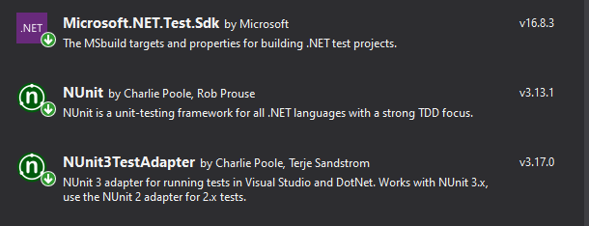
Setup
Create a class project
Install nuget packages
nUnit
nUnitTestAdapter
Microsoft.NET.Test.sdk
Add reference to main project

Slide 5
Standards
Unit Test Project Name : ProjectName.UnitTests / ProjectName.Tests
Unit Test File Name : ModuleName.Tests
Test Name : UnitName_Scenario_ExpectedBehaviour
SUT : System Under Test

Slide 6
Test
Arrange (SUT)
Act
Assert
Running Tests
Run Individual Test
Run All Test
Run During Continuous Integration

Slide 7
Workshop Unit Tests
Setup Calculator Project
[TestFixture]
[Test]
[Ignore]
Assert
Test Explorer
[TestCase]
[Order]
[Setup]
[TearDown]

Slide 8
Workshop TDD
Setup FizzBuzz Project
https://codingdojo.org/kata/FizzBuzz/

Slide 9
Links and Resources
NUnit
https://nunit.org/
GIT Repository of this session
https://github.com/Aliiybar/THT_UnitTests
FizzBuzz Kata Definition
https://codingdojo.org/kata/FizzBuzz/
How To Create a Snippet
https://docs.microsoft.com/en-us/visualstudio/ide/walkthrough-creating-a-code-snippet?view=vs-2019

